Slide 1


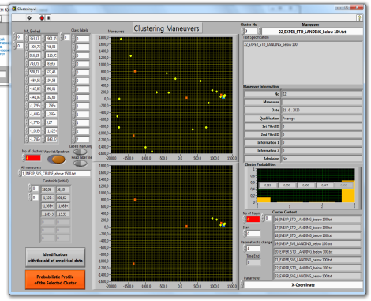
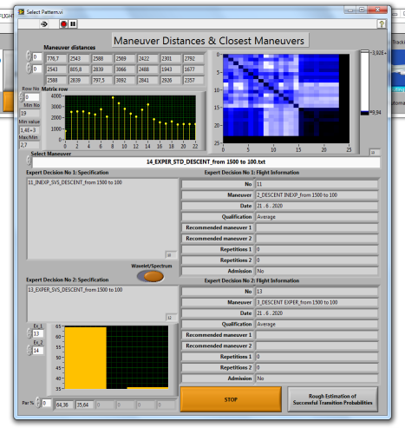
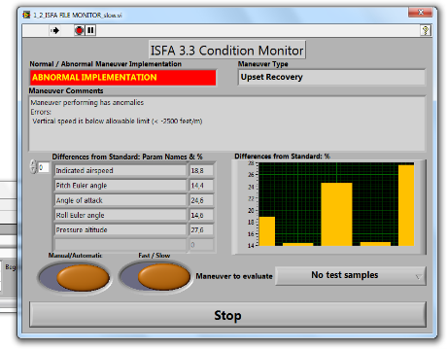

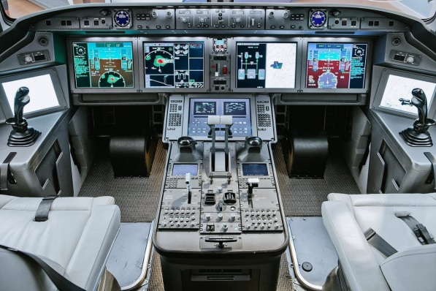
State Research Institute of Aviation Systems (“GosNIIAS)”
MOSCOW STATE UNIVERSITY OF PSYCHOLOGY AND EDUCATION
An approach to diagnostics based on video oculography data analysis
L.S. Kuravsky, G.A. Yuryev, V.I. Zlatomrezhev, I.I. Greshnikov, B.Y. Polyakov

Slide 2
Problem statement (in aviation applications)
The human factor and the level of professional training are now the main causes of critical situations during flight
This factors are still not sufficiently taken into account during safety analysis and design of the cockpit
The modern approach, as a rule, is based only on the analysis of incident statistics
The lack of acceptable mathematical models and methods as well as other effective and reasonable means of assessing the activity and condition of crews is the case
The most promising and valid means for assessing the activity and condition of crews are non-invasive technologies based on the analysis of the characteristics of visual attention.

Slide 3
Various approaches to diagnostics
Cognitive workload
Influence
Video-oculography data
Strong
Average
Optimal
Weak
Physiological load
Thermal imaging, blood pressure, pulsometry, speech analysis, etc.
Strong
12 criteria
Catch phrase: “The eyes are the outside part of the brain”
Statistically significant changes in eye blink rate, pupillary response, eye scanning randomness and visual fixation frequencies and durations and some others were associated with differences in persons cognitive state and performance.

Slide 4
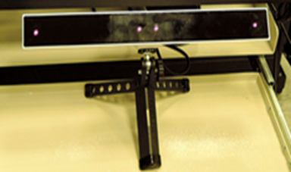
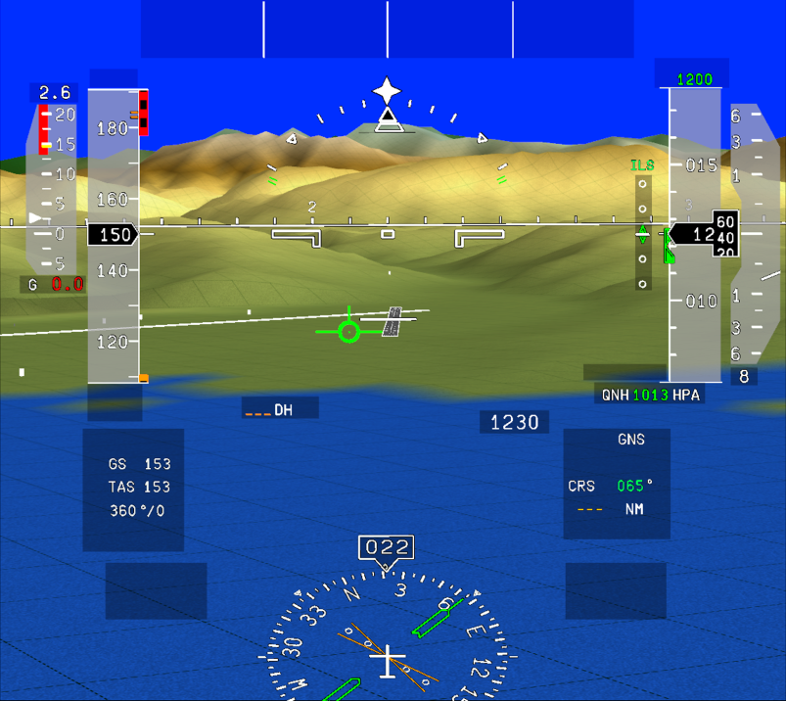
Gaze tracking analysis
Objective assessment criteria have been suggested
The criteria are based on pilot gaze tracking data
Probability of successful pilot actions is estimated
Reliability assessment for these criteria is substantiated by statistical goodness of fit tests
The current state: measurements are accurate and easily available but the corresponding data analysis is difficult and questionable.
Gaze tracking analysis
in human factor study

Slide 5
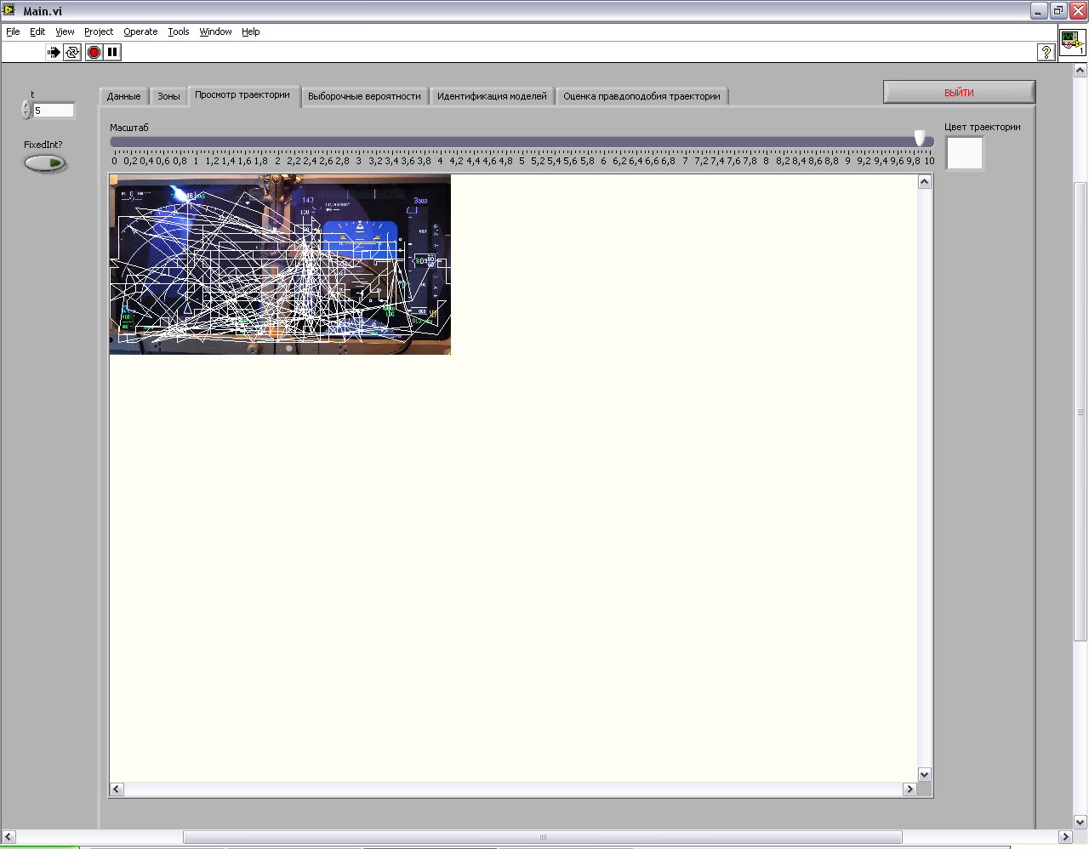
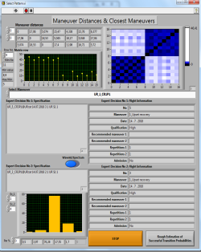
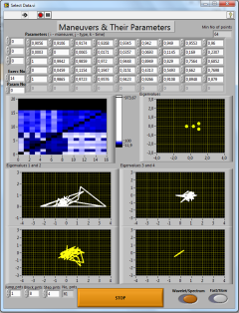
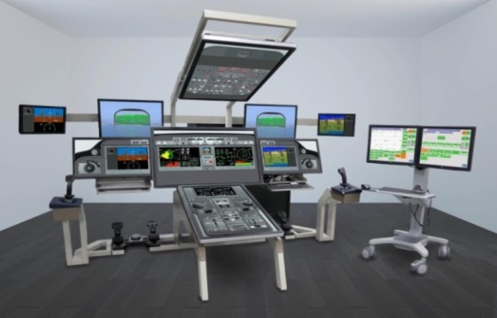
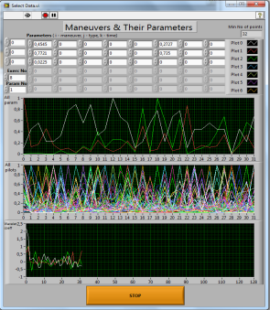
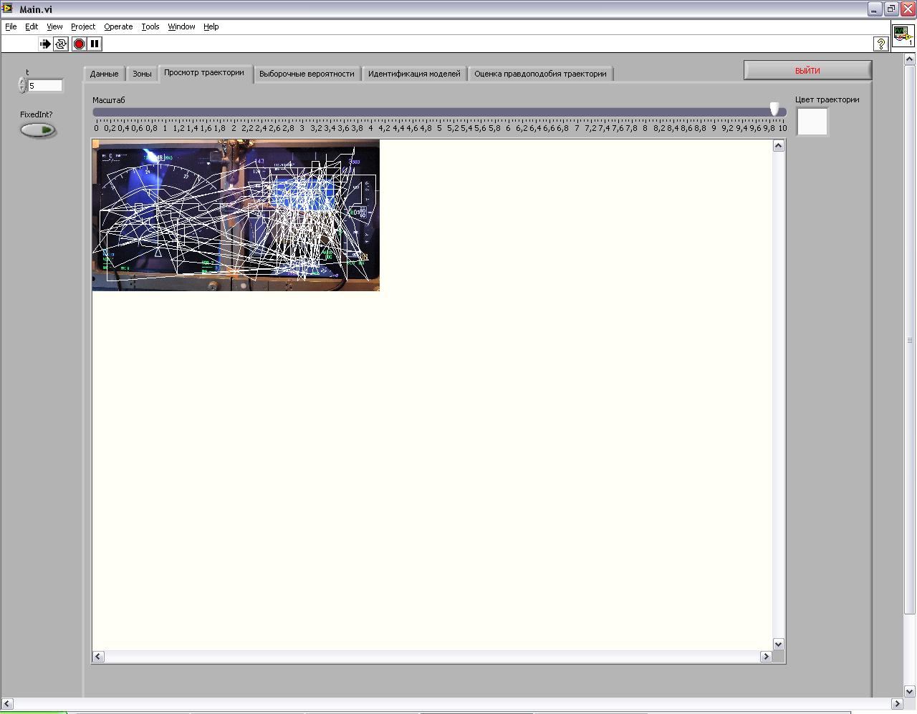
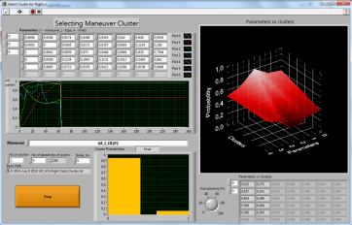
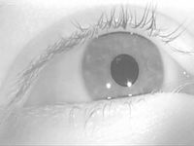
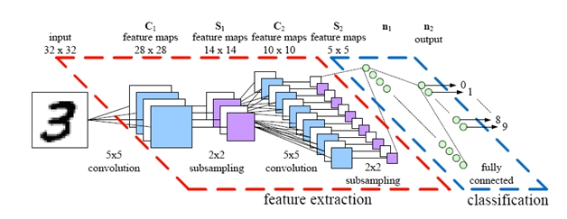
How can we evaluate pilot activity and condition in a cockpit?
Big data (flight fragments)
Artificial intelligence system
(Intelligent System for Flight Analysis)
Gaze tracking data recording
“Raw” gaze trajectories
Primary indexes time series
Identified regression model
Ordinary artificial neural networks
Probabilistic predictor of stress level via gaze tracking data
Deep learning

Slide 6
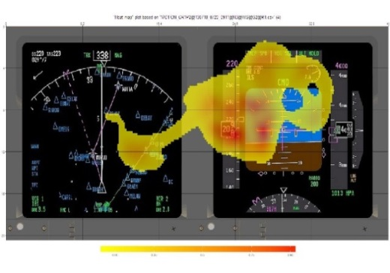
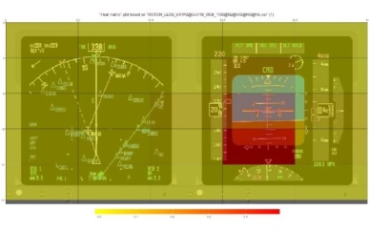
Approaches to gaze tracking analysis
Conventional approaches:
Univariate analysis of static gaze movement primary indexes
Static “heat” maps
Static probabilistic maps.
Failed
New approaches:
Intelligent analysis of multivariate static gaze movement primary indexes
Intelligent analysis of multivariate dynamic gaze movement primary indexes represented by their time series
Intelligent analysis of “raw” gaze trajectories likelihoods based on combination of likelihood estimations by Markov chains, Principal Component Analysis, Multidimensional Scaling, Cluster Analysis, Discriminant Analysis, Markov Model Identification techniques, Parameter Transform Matrix Eigenvalue Analysis.

Slide 7
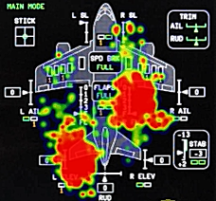
Some indexes for which relation to characteristics of complex system operators has been deduced
Gaze movement primary indexes | To which it serves as a marker/predictor, according to experimental psychology
Amplitude of saccades | Increment of cognitive load
Duration of saccades | Mental diseases, alcohol intoxication
Rate of saccades | Index of level of cognitive activation and level of activity, complexity of the task to be solved, presence of neurophysiological disorders, administration of medicaments and alcohol
Overall duration of fixations | Any experience in solution of the assigned task, difficulties in processing of obtained information, predictor of the cognitive processes' behavior
Number of fixations | Any experience in solution of the assigned task, presence of psychiatric and neurophysiological diseases, any strategies of minimum load on memory
Frequency of fixations | Task complexity
Rate of saccades | Level of load on memory, excitation level, presence of psychiatric and neurophysiological disorders
Results of experimental psychology

Slide 8
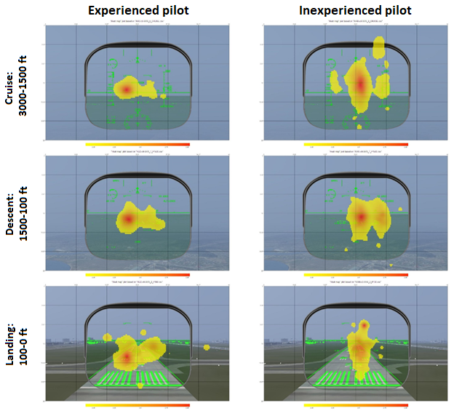
"Heat" maps of the distribution of attention for different modes of flight and pilots with different skills

Slide 9
Analysis of crew activity and condition using gaze tracking data: data, methods and their connections
Samples of flight exercises and GMA data intended for analysis
Crew training level assessing based on video oculography data
Database of flight exercise patterns and GMA
Principal component method: reducing the dimension of the problem and determining representatives of parameters’ groups with high internal correlation (when working with time series of primary GMA indicators)
The calculation of the mutual distances between the exercises in the likelihood metric for comparing trajectories of gaze movement
Multidimensional scaling for the purpose of separating in the scaling space patterns of different types of GMA and normal/abnormal performance results
Expert: selecting clusters of abnormally performed exercises
Private comparison: the contribution of the parameters in the mutual distances between the GMA patterns
Cluster analysis to determine classification rules for separating different types and levels of exercise quality in the scaling space, including abnormally performed exercises
Expert: analysis of the distribution of parameter contributions to mutual distances in order to select relevant characteristics
Multiple comparison: Bayesian likelihood estimation for recognition of belonging to the clusters with detailed contribution of the parameters
Classical / quantum discriminant analysis
Identification of probability models for clusters
Expert: identification and interpretation of abnormally performed exercises and errors

Slide 10

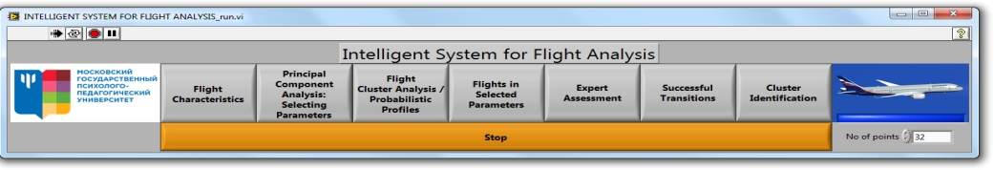
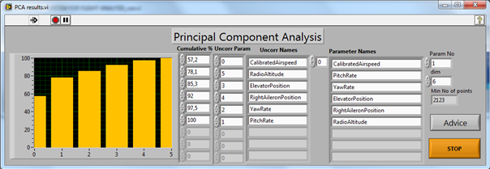
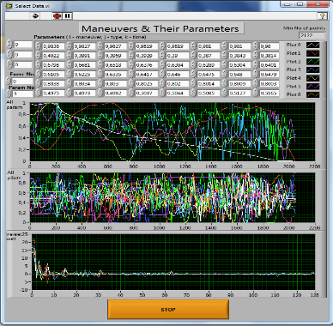
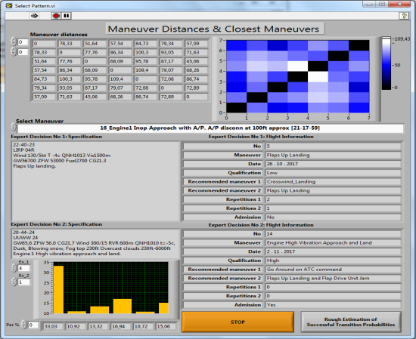
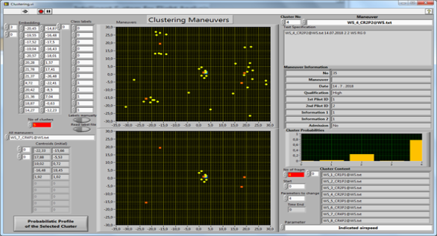
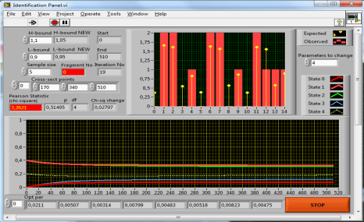
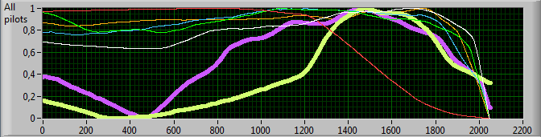
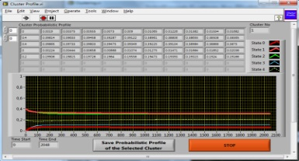
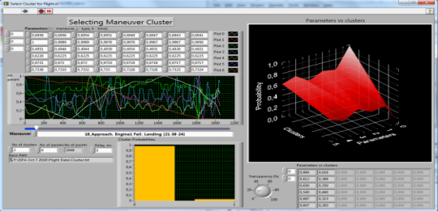
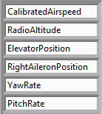
The Intelligent System for Flight Analysis:
Intelligent support and assessment of the level of crew training as a part of the GosNIIAS universal prototyping workbench:
principal steps and their connections, illustrated via screenshots
Data
Principal Component Analysis
Calculating matrix of mutual distances in wavelet coefficient metric
Data check
Multidimensional Scaling
Cluster Analysis
Discriminant Analysis
Parameter’s contributions to the mutual distances
Identification of cluster probabilistic models
Identification and interpretation of abnormalities and mistakes
Bayesian likelihood estimations of piloting skill cluster recognition, containing parameter’s contributions

Slide 11

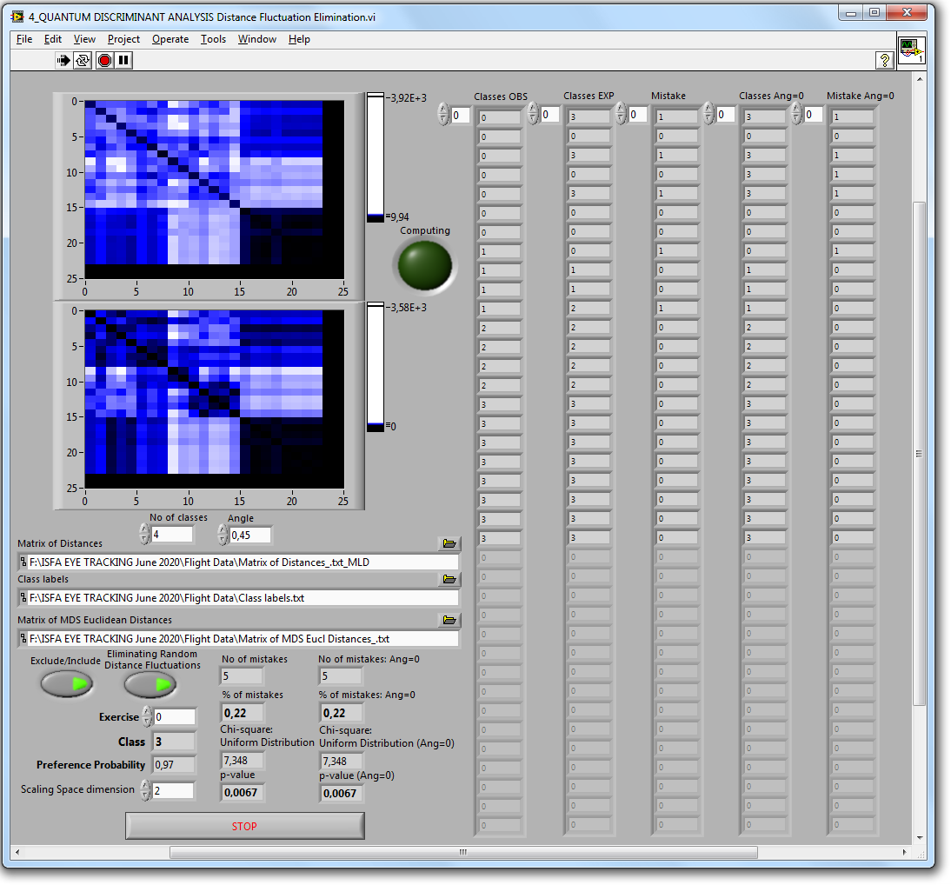

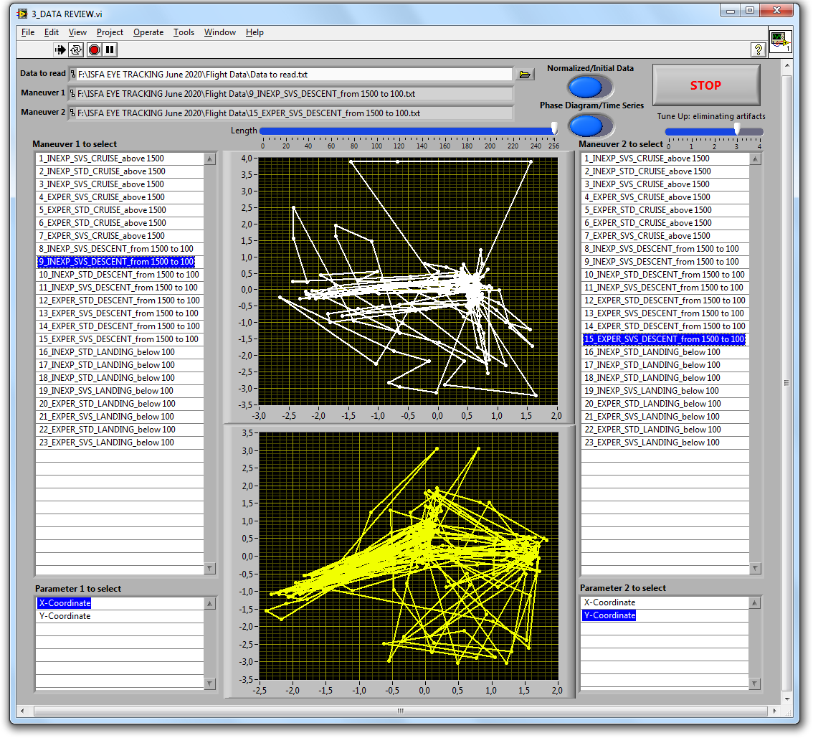


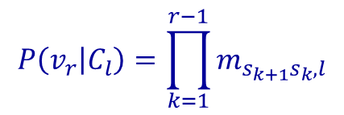
Determination of flight mode and pilot qualification based on video oculography data by evaluating mutual likelihood estimates of gaze movement trajectories and their representing in scaling spaces
$$P\left(v_{r} | C_{l}\right)=\prod_{k=1}^{r−1}{m_{s_{k+1}s_{k},l}}$$
$$p\left(t+1\right)=M_{l}p\left(t\right),$$
$$ln P\left(v_{r} | C_{l}\right)$$
- scores of the likelihood metric

Slide 12
"Heat" maps of the distribution of attention for different modes of flight and pilots with different skills

Slide 13
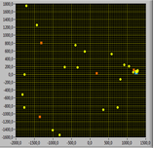
Results of Fischer's discriminant analysis of representations of gaze trajectories in scaling spaces: testing hypotheses about the insignificance of differences in gaze trajectories at different flight phases and for different pilots
F-statistics (df = 2,16) | Inexperienced: cruise 3000-1500ft | Experienced: cruise 3000-1500ft | Inexperienced: descent 1500-100ft | Experienced: descent 1500-100ft | Inexperienced: landing | Experienced: landing
Inexperienced: cruise |  | 0,109 | 7,614 | 21,602 | 4,121 | 5,342
Experienced: cruise | 0,109 |  | 8,133 | 27,583 | 5,334 | 7,000
Inexperienced: descent | 7,614 | 8,133 |  | 15,338 | 25,337 | 29,037
Experienced: descent | 21,602 | 27,583 | 15,338 |  | 55,494 | 59,916
Inexperienced: landing | 4,121 | 5,334 | 25,337 | 55,494 |  | 0,128
Experienced: landing | 5,342 | 7,000 | 29,037 | 59,916 | 0,128
p-values | Inexperienced: cruise 3000-1500ft | Experienced: cruise 3000-1500ft | Inexperienced: descent 1500-100ft | Experienced: descent 1500-100ft | Inexperienced: landing | Experienced: landing
Inexperienced: cruise |  | 0,898 | 0,005 | 0,000 | 0,036 | 0,017
Experienced: cruise | 0,898 |  | 0,004 | 0,000 | 0,017 | 0,007
Inexperienced: descent | 0,005 | 0,004 |  | 0,000 | 0,000 | 0,000
Experienced: descent | 0,000 | 0,000 | 0,000 |  | 0,000 | 0,000
Inexperienced: landing | 0,036 | 0,017 | 0,000 | 0,000 |  | 0,881
Experienced: landing | 0,017 | 0,007 | 0,000 | 0,000 | 0,881

Slide 14
Testing hypotheses about differences in gaze trajectories at different flight phases and for different pilots
Determining the flight mode and pilot qualification based on video oculography data allows us to talk about the possibility of:
  significant discrimination of the pilots' gaze trajectories at different flight phases;
  significant discrimination of the gaze movement trajectories of experienced and inexperienced pilots at certain flight phases, which indicates the prospects of using the presented approach for analyzing video oculography data, especially when classical methods do not allow obtaining useful results.

Slide 15
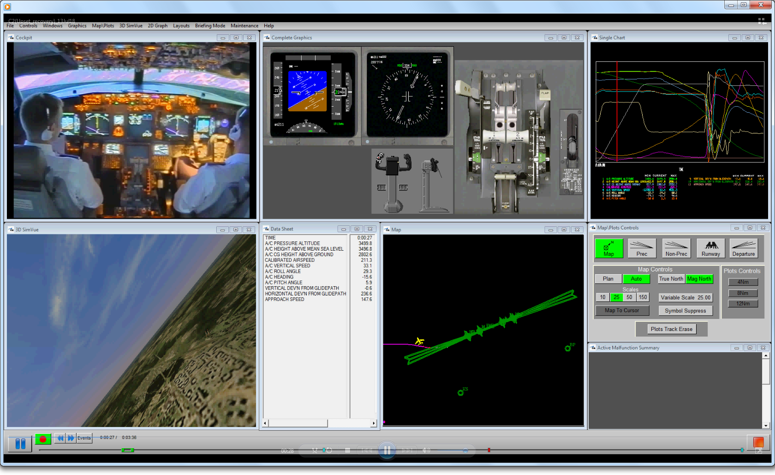
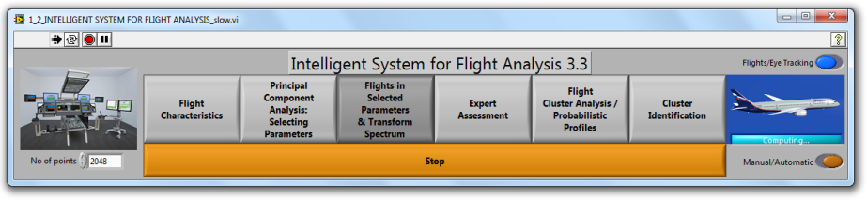

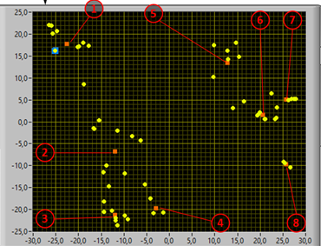
Future prospects: identifying the flight modes performed and the level of crew training basing on the oculomotor activity in automatic mode in real time

Slide 16
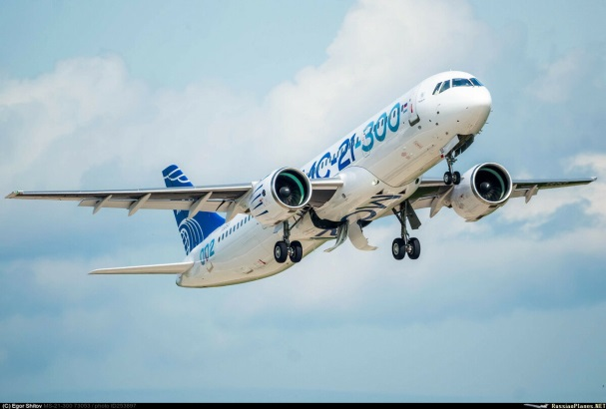
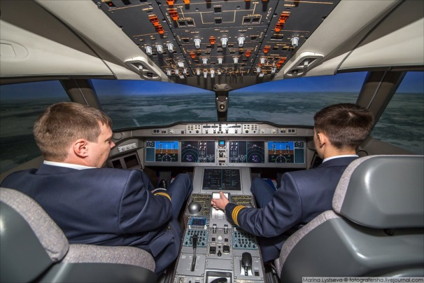
Conclusions
Mathematical models and methods for crew training level assessing based on video oculography data have been developed.
The results obtained can be used for:
  Assessing the crews' work, including training quality control
  Support of supervisor assessments
  Support of modern forms of adaptive crew training
  Comparison of various frames of the cockpit display system and control panels
  Optimization of the cockpit indicators layout
  Comparison of various flight training tools for crews of modern aircraft.

Slide 17
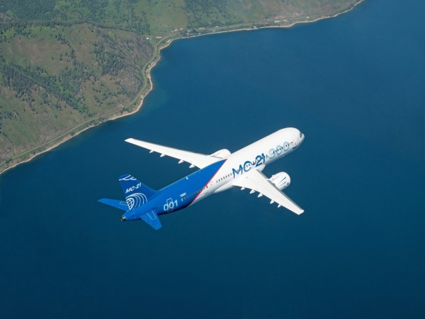

Conclusions
Determining the flight mode and pilot qualification based on video oculography data allows us to talk about the possibility of:
  significant discrimination of the pilots' gaze trajectories at different flight phases;
  significant discrimination of the gaze movement trajectories of experienced and inexperienced pilots at certain flight phases, which indicates the prospects of using the presented approach for analyzing video oculography data, especially when classical methods do not allow obtaining useful results.
The revealed significant discrimination of eye movement trajectories will allow identifying both the flight modes performed and the level of training of pilots based on their oculomotor activity in automatic mode in real time.

Slide 18
Thank you for attention!

